Slide 1


Bank Loan of Customer
Mentor: Dipti Sinha
Group Member:
Mr. Sameer Ahmed
Mrs. Mayuri Kolhe
Tanzeem Shaikh
Chethana H P
Mr. Rutvij Nilangekar
Mrs. Pooja Zagade
Mrs. Mamta Kinge
Group 1

Slide 2
Project Objective
In this Bank Loan Of Customers Project where we provided with two dataset xlsx extension file namely finance 1 & finance 2 having records 39k rows each and the objective was to analyze the growth that bank got within given years in loans.
Our aim was to collect the data from both the file & clean. After analyzing make visuals and give finding (insights) from data that we got.
We used MS-Excel, MySQL for analyzing & cleaning the datasets and prepared dashboards using Tableau and Power BI tools where we did calculations, merging and prepared interactive dashboards.

Slide 3
contents
KPI 1. Year wise amount Stats
KPI 2. Grade & Sub-grade wise Revolving Balance
KPI 3. Total Payment for Verified Status Vs Total Payment for Non- verified Status
KPI 4. State wise and Last credit pull date wise Loan Status
KPI 5.Home ownership Vs Last payment date stats.

Slide 4
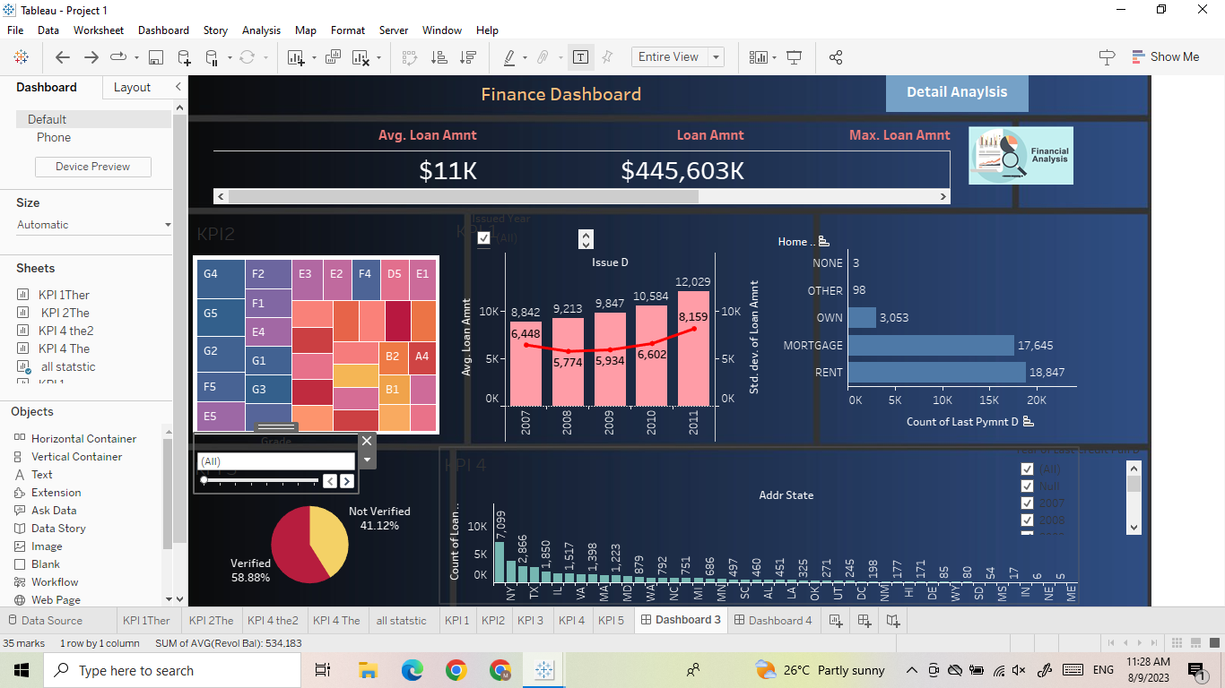
KPI 1: Year wise loan amount stats
By observing this graph we can conclude that Loan amount is increasing by year.
Starting from 2007 the loan amount is 8,842k and in the year 2011 the loan amount is 12,029k. If we subtract 2011 loan amount from 2007 loan amount then we can get difference between loan amount i.e., 3187k.
3187k loan amount increased in the duration of 4 years.
Grand Total of Loan amount is 446 M (Millions).

Slide 5
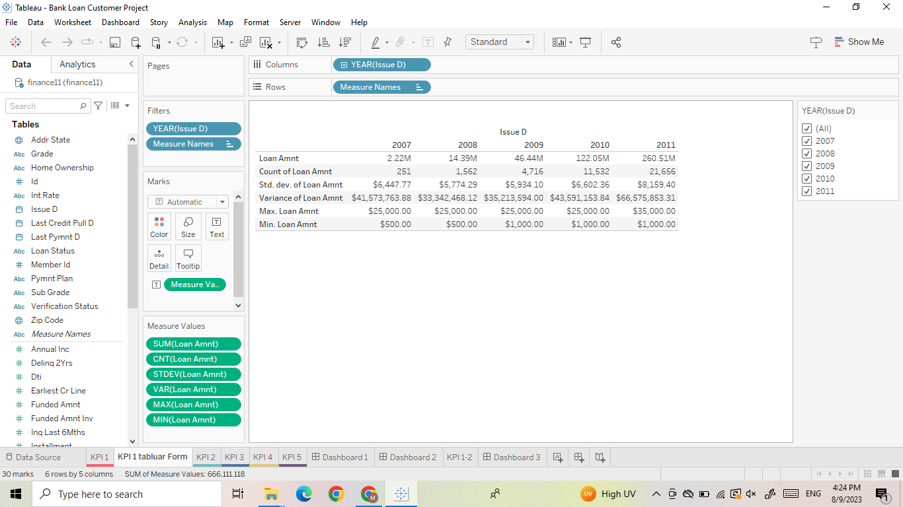
KPi : 1 Sub charts
Total Loan amount $446 M
Total average amount
$11.22 k
Total accounts 39,717
Min loan amount is $500
Max loan amount is $35K

Slide 6
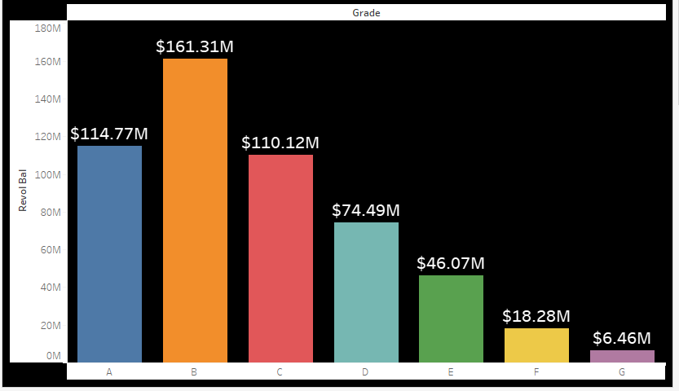
KPI 2 Grade & Sub-grade wise REVOL bALance
In this graph Grade wise revolving balance is shown.
Grade B have more Revolving balance than any other grade which is $161.31M hence more number of customers took loan in Grade B
Grade G have less Revolving balance than any other grade which is $6.46M
Order for Grade wise Revolving balance is,
B>A>C>D>E>F>G

Slide 7
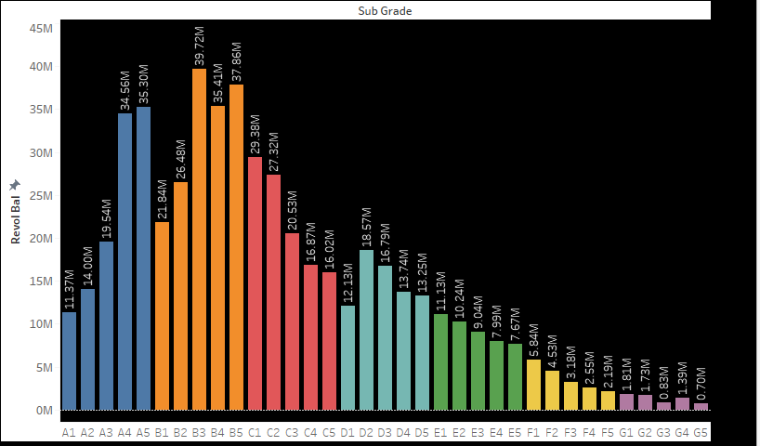
KPi 2 sub chart
In this graph we can see sub-garde wise revolving balance:
As we can see B3 has more revolving balance 39.72 M & G5 has less revolving balance 0.70 M
If we take first 5 sub-grade having revolving balance is more they are
B3>B5>B4>A5>A4.

Slide 8
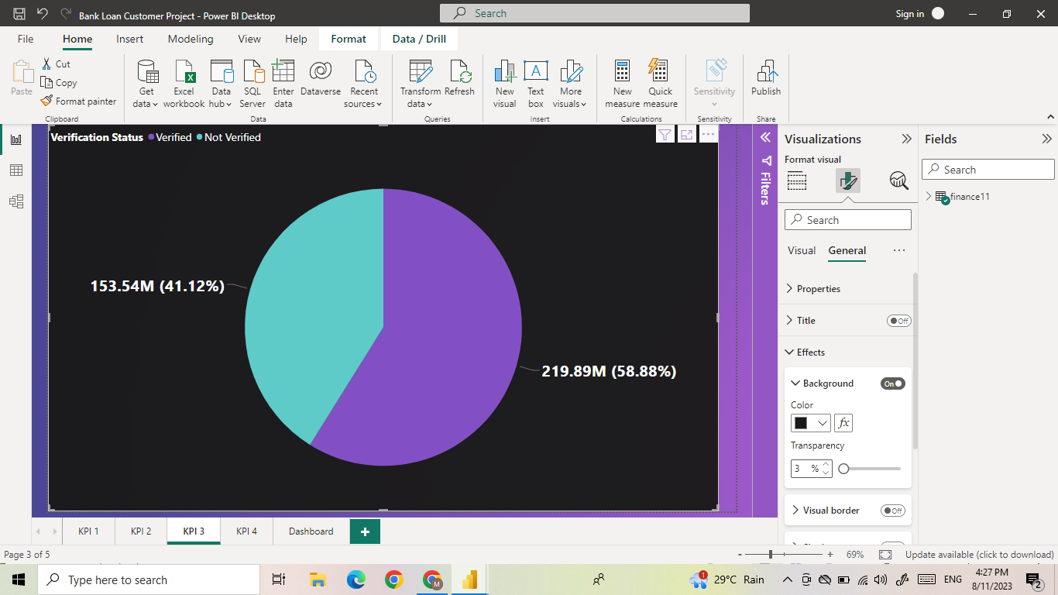
KPI 3 Total Payment for Verified Status Vs Total Payment for Non-verified Status
Total payment for Verified status is 58.88% (with amount 219,89 M) & Total Payment for Non-verified Status is 41.12% (with amount 153,54 M)
Total Payment amount is 373.43 M
Total payment for verified status is higher than Non-verified status.

Slide 9
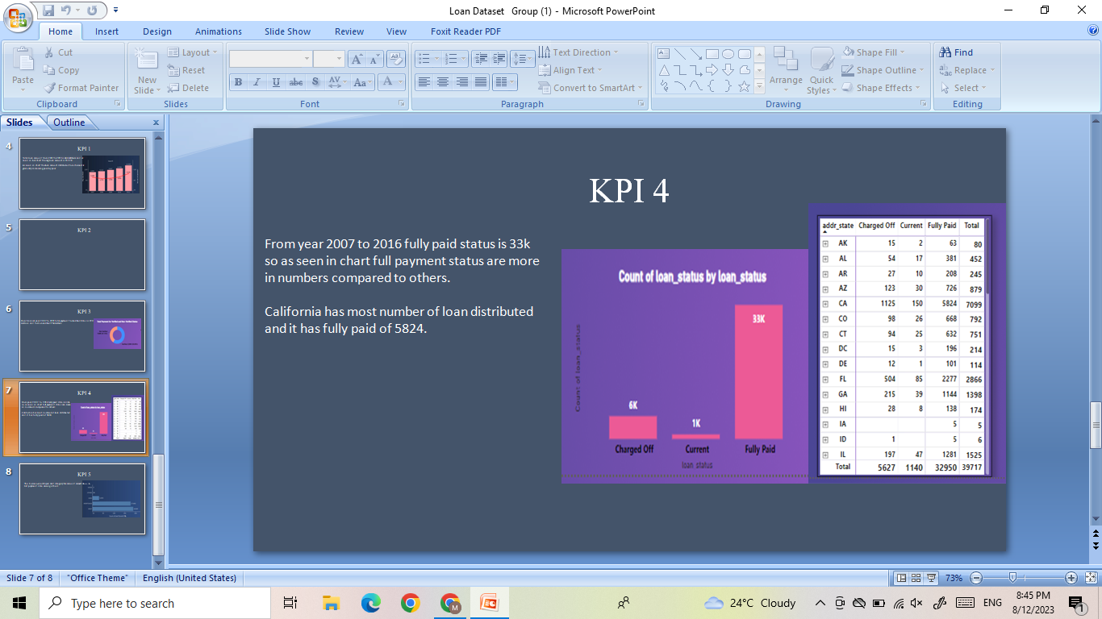
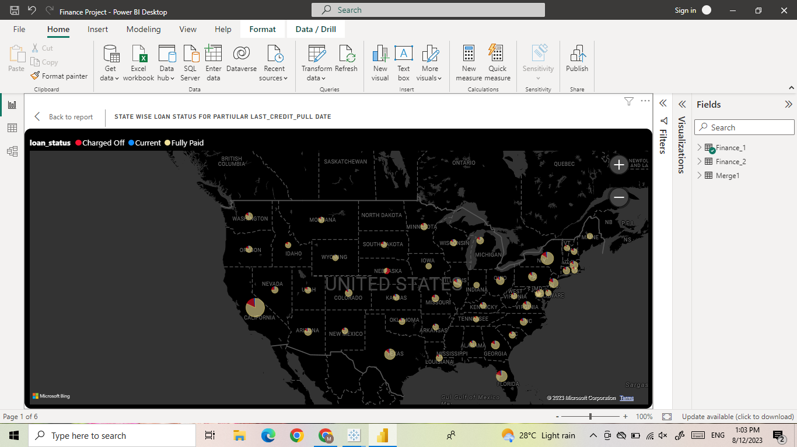
Kpi 4 state wise & last credit pull date wise Loan status
This Graph shows the count of loan status in each state of USA on particular last credit pull date.
As we can see state CA has maximum customers who took loan i.e., > 5000 is the count of loan status.
The percentage of bank customers loan status for each states are:
Full Paid - 86.96%
Charge off – 14.17%
Current - 2.87%

Slide 10
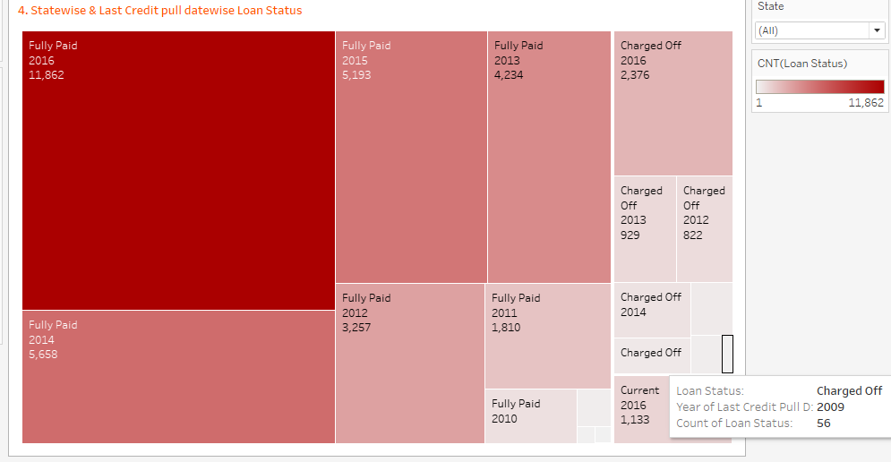
KPI 4 sub chart
In this graph we can see Last credit pull date wise loan amount (year wise) status:
In the year 2016 has higher fully paid count of loan status which is (11,862K) similarly charge off loan status (2376k) & loan status for current is (1133k)
The lowest count of loan status found in 2009 which is 56.

Slide 11
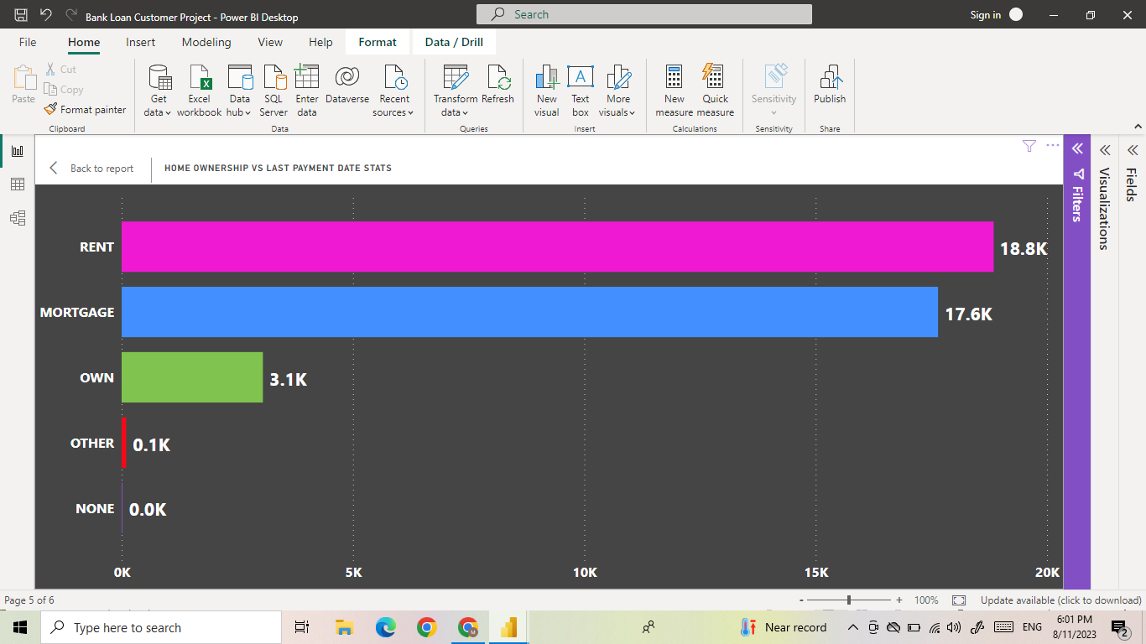
KPI 5 Home ownership vs Last Payment Date stats
This graph shows Home ownership and the amount paid for each on last payment date.
Last payment loan amount is paid highest by rent for latest date.
Here this graph shows total loan took by customers for each home ownership with int & amount paid to the bank and their loan status.
We can conclude that in each home ownership, min loan amount is taken for others.

Slide 12
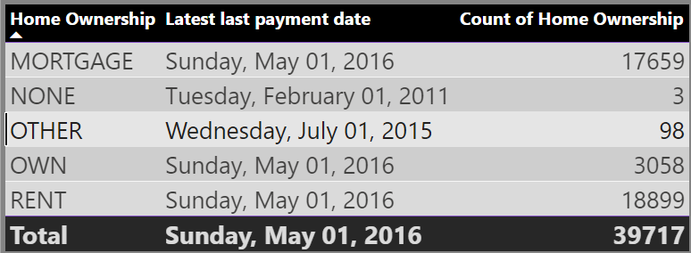
KPI 5 sub charts
This table shows the home ownership & the amount paid for each on last payment date.
We can see that maximum latest amount paid by customers with Rent home ownership is 18,899.
It can be observe that Many of the customers are about to repay their loan amount for their particular home ownership.

Slide 13
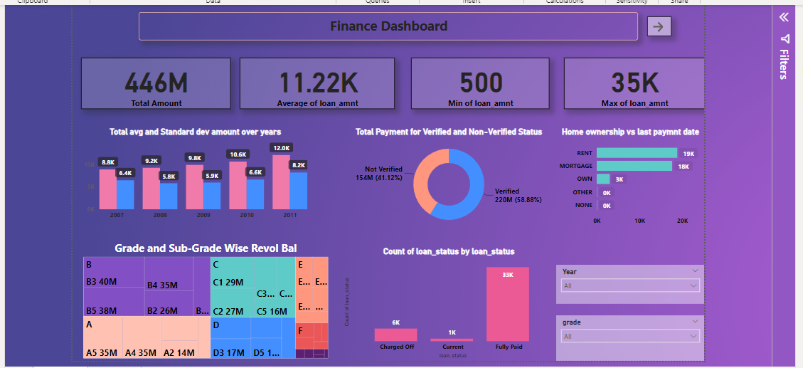
Bank loan of customers analysis

Slide 14
THANK YOU

